Slide 1
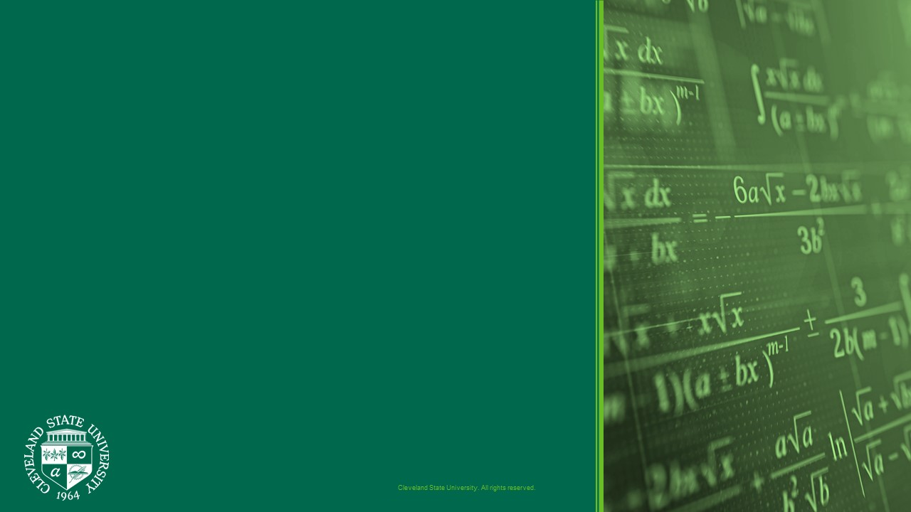
Neural Networks
Hongkai Yu
Cleveland State University

Slide 2
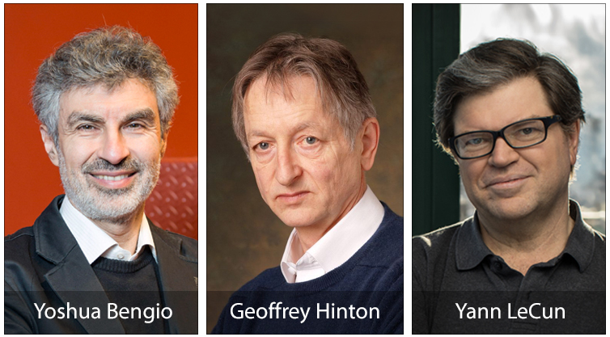
2018 Turing AWARD
Godfathers of AI

Slide 3
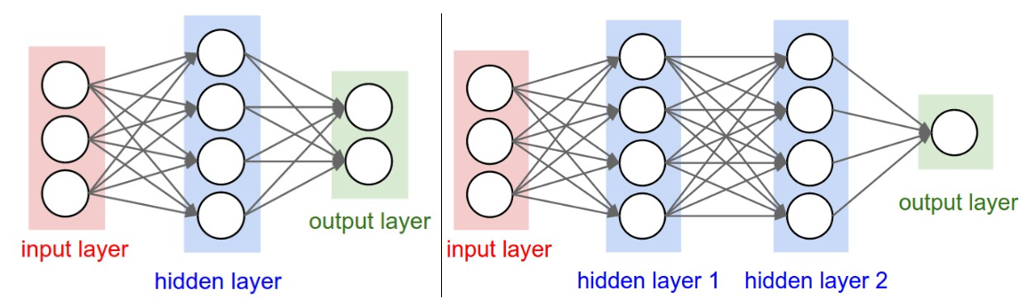
architectures
Layer-wise organization: fully-connected layer
Also named as “Artificial Neural Networks” (ANN) or “Multi-Layer Perceptrons” (MLP)

Slide 4
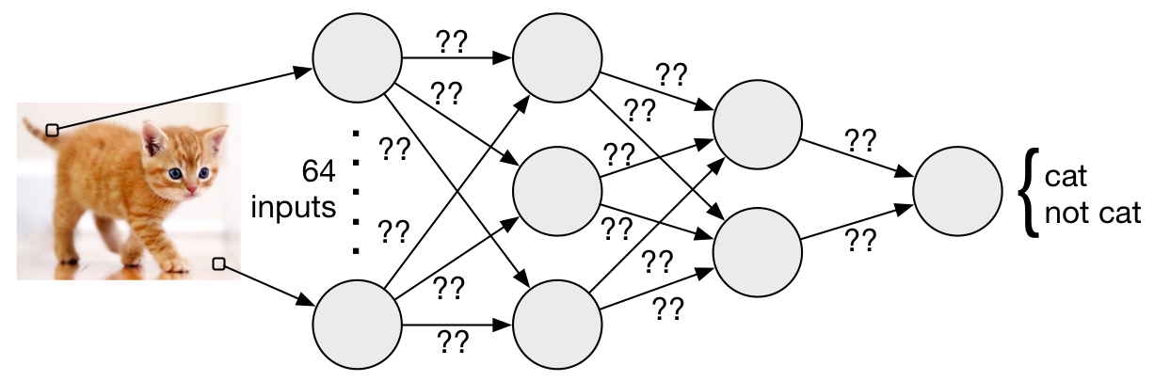
NN for classification

Slide 5
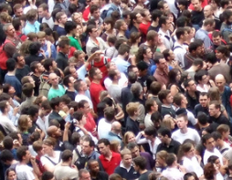
NN for Regression
122

Slide 6
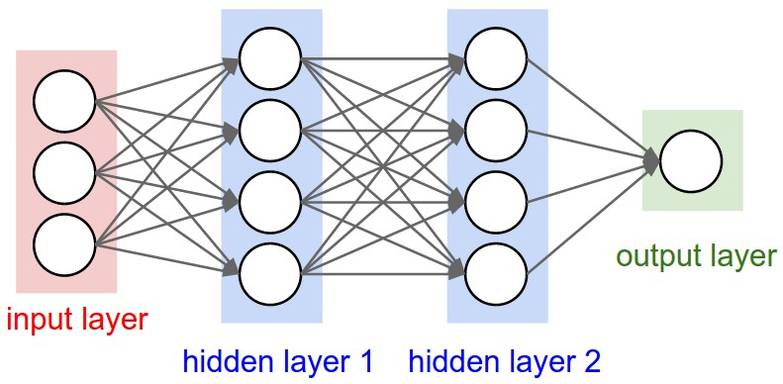
NN for Regression
Traffic speed
in t-2, t-1, and t
Traffic speed
in t+1

Slide 7
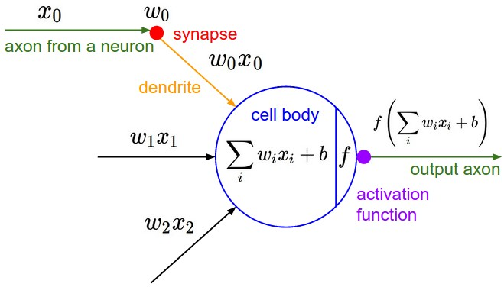
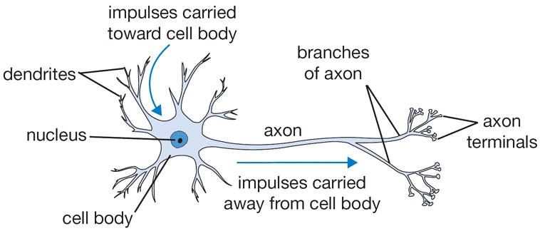
Biological motivation and connections
A cartoon drawing of a biological neuron
Mathematical model

Slide 8


Mathematical model
w0
x0
w1
x1
w2
x2
f: activation function

Slide 9
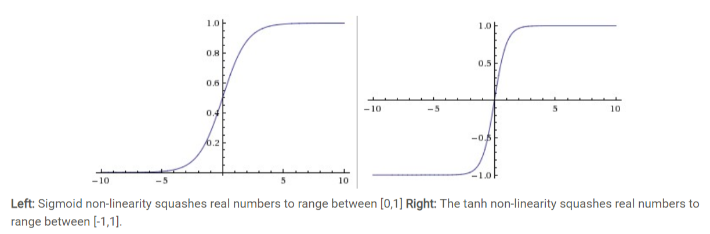


Commonly used activation functions

Slide 10
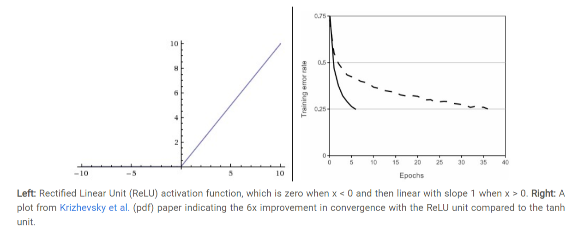
Rectified Linear Unit (ReLU) activation function

Slide 11
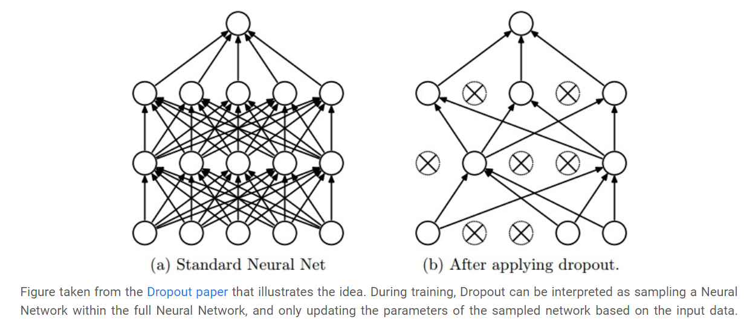
DRopout

Slide 12

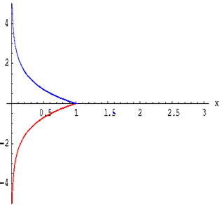

cross entropy loss for classification
Input: an n-dimensional vector
Output: rescaled n-dimensional vector, where each element is in the range (0,1)
and sum to 1.
(think it as a probability)
- log(x)
log(x)
Let us have some examples: 1000 classes for image classification

Slide 13
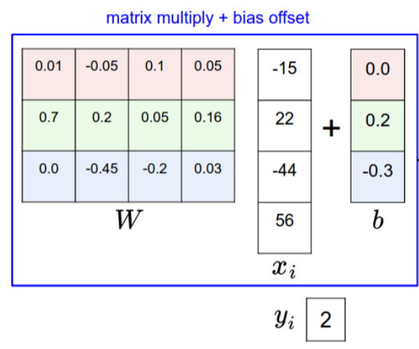
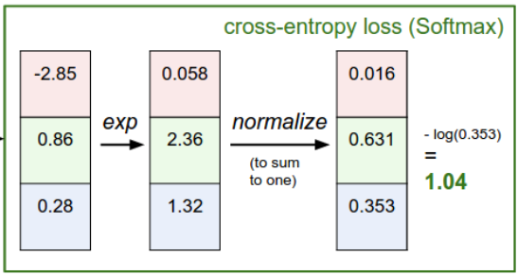
cross entropy loss: example

Slide 14
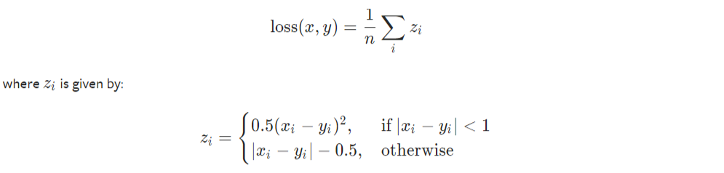
Smooth l1 loss for regression
Let us have some examples: crowd people counting or object detection

Slide 15
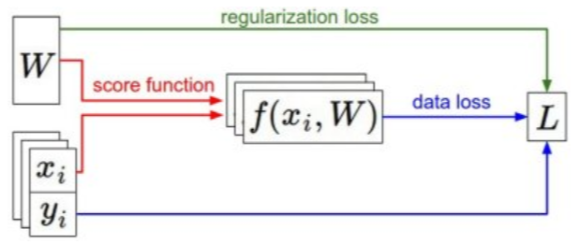
Stochastic gradient descent (SGD)
Training NN: adjust the NN parameters based on the negative direction of the gradient so as to minimize the loss function
A simple way to update the NN parameters:
W = W – learning_rate*gradient
By iterative refining the NN parameters

Slide 16
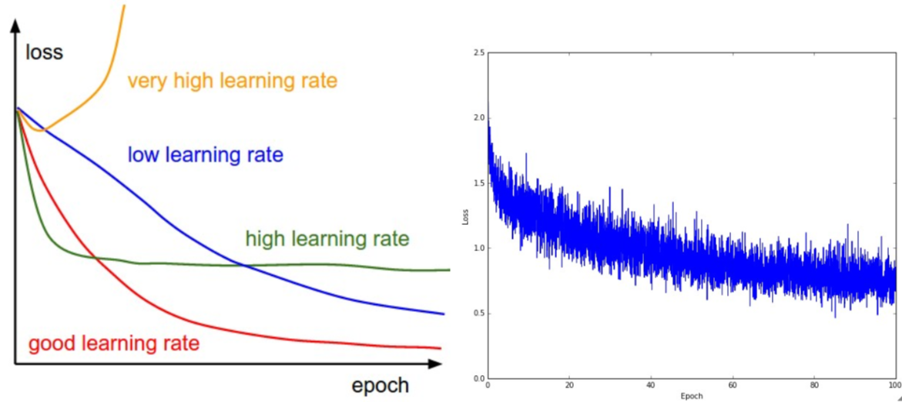
Learning process

Slide 17
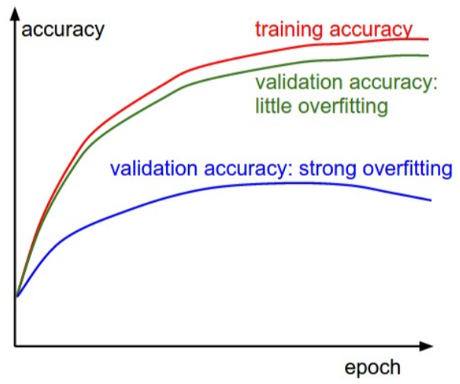
Learning process

Slide 18
FORWARD: from input to output
NN parameters W are first randomly initialized.
Forward
Backward

Slide 19



Gradient

Slide 20






chain rule for Gradient computation

Slide 21
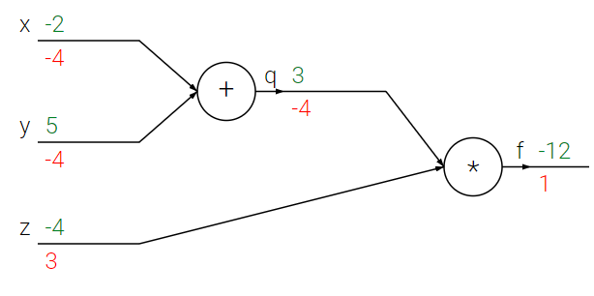


BACKWARD: loss can be decreased if we have the gradients of each layer
Forward
Backward
Performs backpropagation which starts at the end and recursively applies the chain rule to compute the gradients (shown in red) all the way to the inputs.
Backward

Slide 22

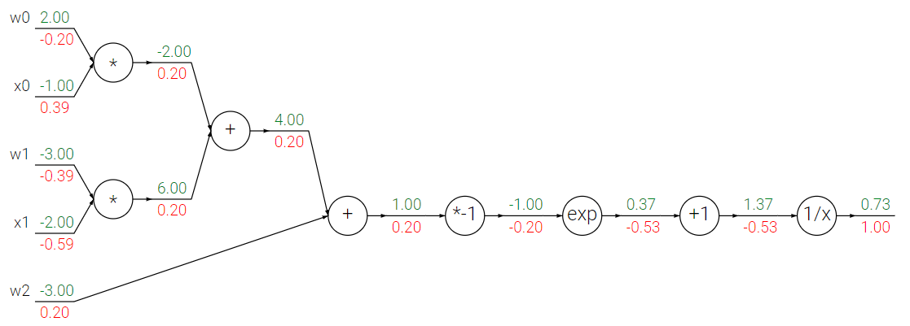
backpropagation: example

Slide 23
backpropagation: example
x0*(0.20)
1*(0.20)
w0*(0.20)
1*(0.20)
x1*(0.20)
1*(0.20)
w1*(0.20)
-1/(1.37)²
-1*(-0.20)
1*(-0.53)
1*(0.20)
(-0.53)*exp(-1)

Slide 24
Training
0. Randomly initialize the NN weights.
1. Forward: compute the output and loss based on current NN weights.
2. Backward: adjust the NN weights by SGD during the backpropagation so as to iteratively decrease the loss.
3. Go back to Step 1 until convergence.

Slide 25
Testing
After training, the optimal NN weights are obtained.
Given a new input (testing) data, just perform the FORWARD to get the output.
Computation cost: low

Slide 26
Training difficulty
How to train the NN if I have a large-scale dataset?
Such as: 1 million images.
Feeding all the data (images) together into the NN needs an extremely large memory.

Slide 27
Batch size Training
How to train the NN if I have a large-scale dataset?
Solution: Mini-batch SGD
Mini-batch SGD:
Train NN with different batches
Popular batch sizes include 32, 64, and 128 samples.
Advantages: Less memory, Training faster

Slide 28
Thank you
Reference:
Cs231n @ Stanford University: http://cs231n.github.io/
Pytorch tutorial: https://pytorch.org/tutorials/

